Slide 1
4C for Children Meet-up
Step Up to Quality
Learning and Development Standards

Slide 2
welcome

Slide 3
Standards
Learning and Development: Curriculum and Assessment
Obtain and implement for all infant, toddler and preschool aged children a comprehensive research-based curriculum that is aligned with the ELDS and the Science of Reading.
Complete a comprehensive formal child assessment aligned to the ELDS for all infant, toddler, and preschool aged children twice annually.
Provide intentional and purposeful activities as determined from the child assessments.
SA: Classrooms provide activities that are aligned with the Ohio K-12 Learning Standards
Utilize assessment results to adjust and refine instruction.
Notes:
.

Slide 4
Learning and development
Bronze Level
Curriculum and Assessment
Implement a comprehensive, research-based curriculum that is aligned with the Early Learning and Development Standards (ELDS) and the Science of Reading.
School age: Provide activities aligned with the Ohio K-12 Learning Standards.
Onsite Evidence Requirements
Selected curriculum is from verified list.
Curriculum materials are available for lead teachers/FCC Providers.
Required activity/lesson plans.
Current activity/lesson plans from the verified curriculum.

Slide 5
Curriculum implementation verification
Lead teachers and family child care providers should have access to curriculum materials, which can be available either electronically or hard copy.
Lesson/activity plans are current and include experiences from the curriculum being used.

Slide 6
Curriculum implementation verification
The activities in the classroom should align to the lesson plans and should include all hours of instructional time.
Sample activity plan (previously form 1513) has been revised and is available on DCY website.
School-age activity/lesson plans should follow the K-12 standards.
Programs do not need to align to all K-12 standards but should align the activities to the standards that best support their philosophy and program goals.

Slide 7
Learning and development
Silver Level
Curriculum and Assessment
Complete a comprehensive, formal child assessment aligned to the Early Learning and Development Standards (ELDS) for all infant, toddler and preschool aged children twice annually.
Onsite Evidence Requirements
Assessment tool is from verified list.
Assessment is completed twice annually, and results are shared with families.
Evidence gathered to complete the assessment.
Lead Teachers/FCC Provider can explain the child assessment process, including methods used and how results are shared with families.

Slide 8
Child Assessment Verification
A list of assessments aligned to the ELDS will be posted on both the Department of Children and Youth and the Department of Education and Workforce websites.
School age children are not required to have an assessment completed, and therefore will not need to meet the requirement for intentional and purposeful activity planning for this age group.
A sample individual child activity plan is available for programs that would like to use one.

Slide 9
Learning and development
Gold Level
Curriculum and Assessment
Provide intentional and purposeful activities as determined from child assessments.
Utilize assessment results to adjust and refine instruction.
Onsite Evidence Requirements
Intentional and purposeful activities and experiences determined from the child assessment results.
Lead Teachers/FCC Provider can explain the child assessment process, including how results are used to plan, adjust, or refine instructional strategies.

Slide 10
Frequently Asked Questions
How will I know if a curriculum is aligned to the ELDS and Science of Reading?
Lists of aligned curricula can be found on the Department of Education and Workforce website and the Department of Children and Youth website.
If my curriculum is not on the list, does that mean it is not aligned?
If your curriculum is not on the list, please submit your curriculum for review. Some curricula have been submitted and are in the process of being reviewed. Others may not yet have been submitted.

Slide 11
Frequently Asked Questions
What curriculum as been chosen as the state purchased curriculum?
Infant, toddler, and preschool editions of Creative Curriculum, 6th Edition, available for child care centers and schools to order. It does include one hard copy curriculum set, per age group, per licensed site, available in English or Spanish. A family child care curriculum has not been chosen yet.
Is Teaching Strategies Gold included?
Teaching Strategies GOLD Assessment digital portfolio included in contract. Digital portfolios can be requested per child for infant, toddler, and preschool ages. Order process will be integrated with curriculum order. Programs who currently use the Creative Curriculum may request GOLD Assessment without requesting the curriculum.

Slide 12
Frequently Asked Questions
What curriculum has been approved for Infant & Toddler Curricula?
Creative Curriculum for Infants, Toddlers & Twos, Creative Curriculum for Infants, Creative Curriculum for Toddlers, Experience Early Learning , Learning Beyond Paper
What curriculum has been approved for Preschool Curricula?
Creative Curriculum for Preschool, 6th Edition, Frog Street PreK (2020), High Scope Preschool 2nd Edition, PreK On My Way (2020), Ready to Advance (2012; Preschool), World of Wonders (2017)

Slide 13
Standards
Learning and Development: Child Screening
Administer or confirm completion of a comprehensive screening tool within sixty days of enrollment for newly enrolled children and annually for all children.
Refer families, whose children had an identified need, within sixty days from the date of the completed screening.
Follow-up with families within thirty days from date of referral to determine if the child’s needs are being met for services.
Share or confirm results with families within thirty days following the completion of the screening

Slide 14
Learning and development
Bronze Level
Child Screening
Administer or confirm completion of a comprehensive screening tool within sixty days of enrollment for newly enrolled children and annually for all children.
Share or confirm results with families within thirty days following the completion of the screening.
Onsite Evidence Requirements
Documentation of completed screening and documentation that results were shared with families.

Slide 15
Child Screening Verification
The comprehensive screening tool is required to be completed only for infant, toddler, and preschool age children.
The screening tool should include:
Child's name
Date of completion within 60 days of enrollment and then annually
Completed scoring according to screener instructions
Comprehensive screening (language, cognitive, motor, social and emotional, and behavioral)

Slide 16
Learning and development
Silver Level
Child Screening
Refer families, whose child had an identified need, within sixty days from the date of the completed screening.
Onsite Evidence Requirements
Documentation of the referral process and the referrals made to families.

Slide 17
Learning and development
Gold Level
Child Screening
Follow-up with families within thirty days from the date of referral to determine if the child's needs are being met for services.
Onsite Evidence Requirements
Documentation of the follow up process and any follow ups with families to determine if needs were met.

Slide 18
Frequently Asked Questions
Do you have a list of sample tools that are comprehensive and could be used to complete child screening?
A comprehensive list will be posted on the Department of Children and Youth website soon.
Can providers use the free ASQ online to meet the child screening requirement?
Yes. Providers can become ASQ/Sparkler partners and access ASQ results on a provider dashboard. Additional information about this functionality can be found on helpmegrow.org.

Slide 19
Program standard changes Learning and development
Developmental and Educational Goals
Removed requirement to create two written developmental and educational goals within 60 days of enrollment.
Child Assessments
Informal child assessments are no longer required for school age children.

Slide 20
SUTQ Inspection Cycle
July 1, 2024 – June 30, 2025
Currently rated programs will be offered a technical assistance visit
Beginning July 1, 2025
Bronze programs will receive a full on-site verification visit every other year
Silver and Gold rated programs will receive a full on-site verification visit every three years
Programs registering for an initial or change in rating will receive a verification visit

Slide 21
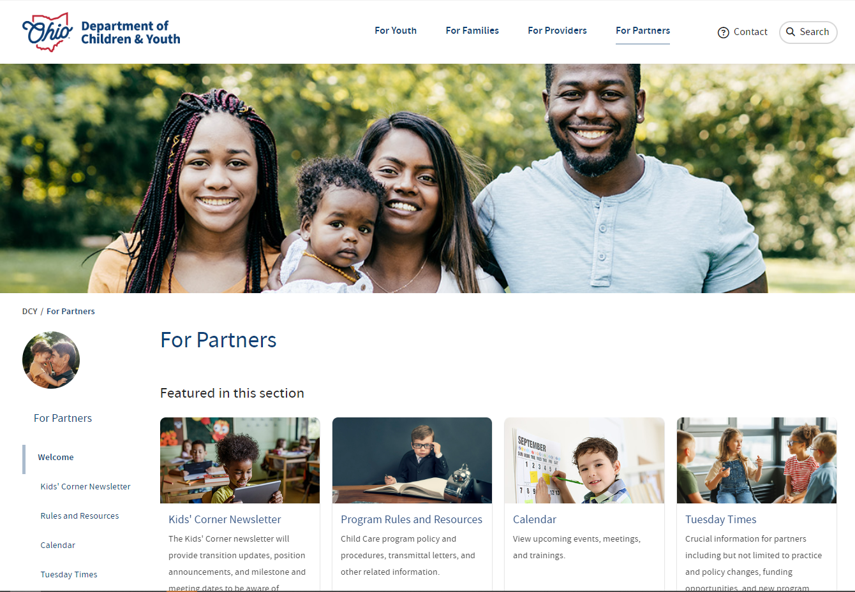
Stay informed
Visit:
childrenandyouth.ohio.gov
Click on:
For Partners at top of page
Click on:
Tuesday Times on left of page

Slide 22
Notes:
Thank you for joining us.

